Slide 1

Osmany Hall Messing System
GROUP - 6
Notes:
We designed this template so that each member of the project team has a set of slides with its own theme. Members, here’s how you add a new slide to just your set:
Mark where you want to add the slide: Select an existing one in the Thumbnails pane, click the New Slide button, then choose a layout. The new slide gets the same theme as the other slides in your set.
Careful! Don’t annoy your fellow presenters by accidentally changing their themes. That can happen if you choose a different theme from the Design tab, which changes all of the slides in the presentation to that look.

Slide 2
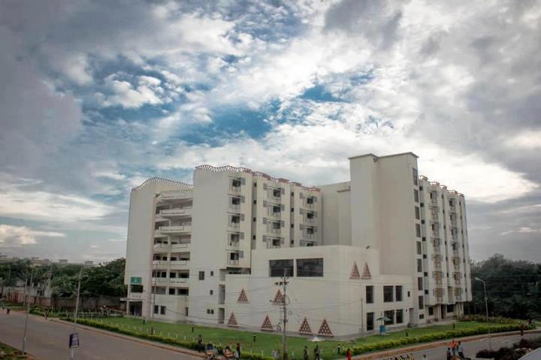

Slide 3

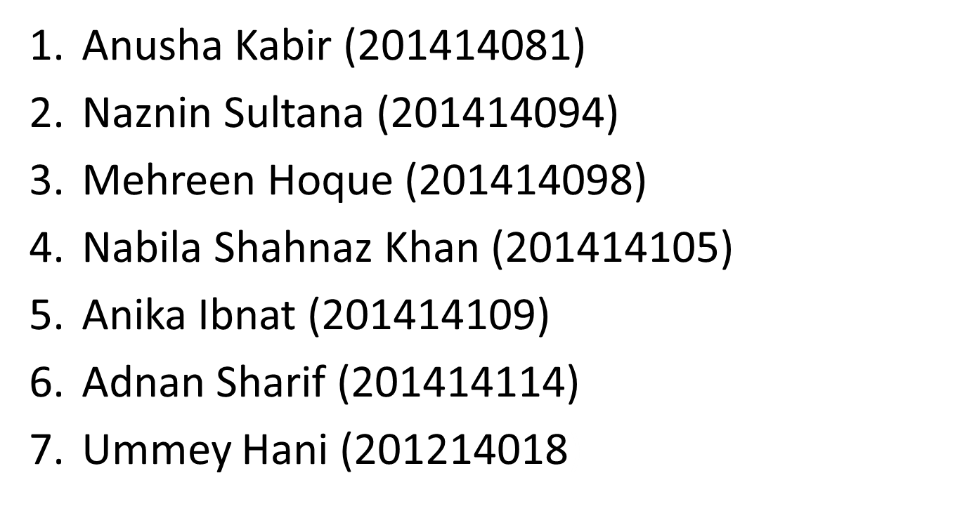
Group Members

Slide 4

Introduction
A software requirements specification (SRS) is a description of a software system to be developed. It lays out functional and non-functional requirements, and may include a set of use cases that describe user interactions that the software must provide.

Slide 5
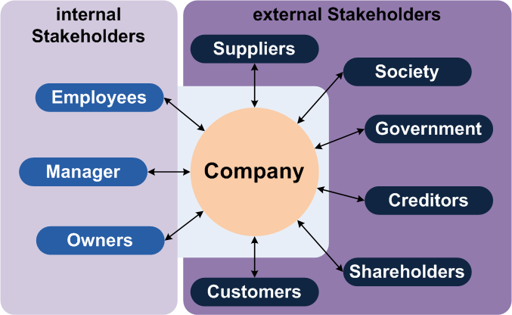
Stakeholders
A stakeholder is a party that has an interest in a company, and can either affect or be affected by the business. The primary stakeholders in a typical corporation are its investors, employees and customers.

Slide 6

Stakeholders
Students
Hall Staffs
Hall Manager
Hall Authority

Slide 7

Stakeholders
System Managers:
Database administrator
IT officers and server room
officers
System Owners:
key contributor in developing system design specifications to ensure the security
External Stakeholders:
Bank that conducts the money transactions of the hall.

Slide 8
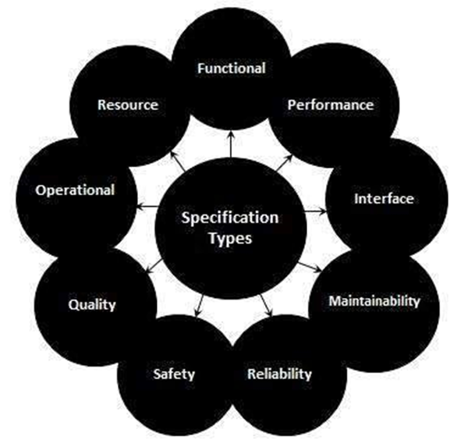
Types of Requirements

Slide 9
Our Basic Requirements
1.Online meal sign for students
2.Not allowing to sign other student’s meal
3.Providing sufficient time to hall stuff to entry necessary information
4.Providing secured access of the hall accounting system only to manager and authority
5.Facility to see both hall and mess bill online
6.Facility to see urgent hall notices online

Slide 10
User &System requirements
User requirements are a list of features an application must/should have. For our hall messing system, the possible users are the students, hall staffs, hall manager and hall authority( provost, assistant provost).
System requirements represent all of the requirements at the system level that describe the functions which the system as a whole should fulfill to satisfy the stakeholder needs

Slide 11
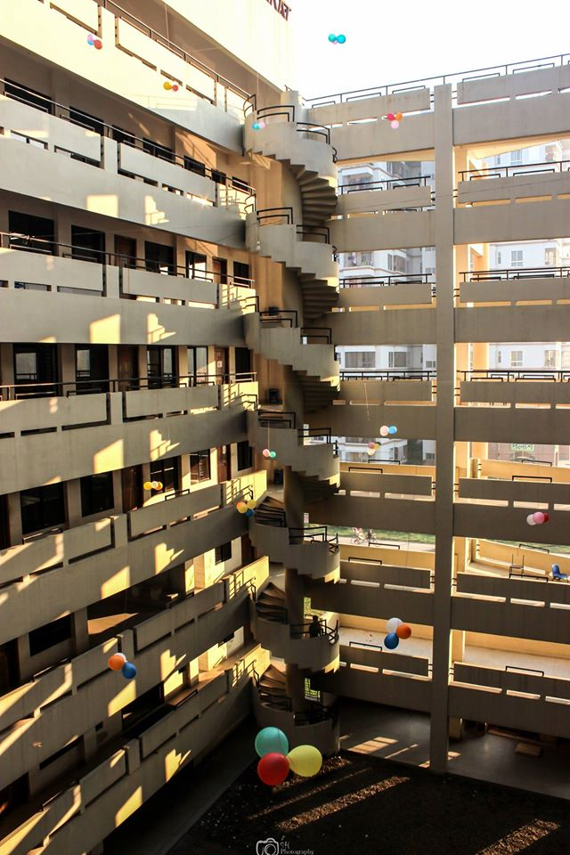
Types of Requirements:
Students:
For User:
1. Students should be able to on/off meal anywhere anytime.
For System:
1.1 Student can sign on/off their meal for the next day.
1.2 They have to sign it before 2230 hours because after that time the hall staffs has to order meal.
1.3 Students can sign it from anywhere through website but he needs to log in to his account using his hall id and password.

Slide 12
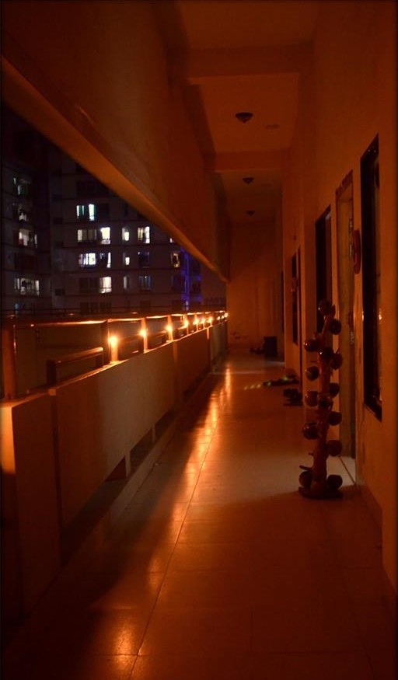
Types of Requirements
Students:
For User:
2. Students should be able to view the mess bill and hall bill.
For System:
2.1 Students can view their bill of previous months.
2.2 Students can also view if the bill is paid or not.
2.3 Students can see the amounts they have paid till last month from the beginning For User:
3. Students should be able to read notice.
For System:
3.1 Students can read the notice through website.
3.2 There will be a notice section in website

Slide 13
Types of Requirements
Hall staffs:
For User:
4. Hall staffs should be able to input purchased groceries and the amount.
For System:
4.1 Should be able to input purchased groceries for the previous days up to today.
4.2 Four columns: item name, price per unit, total unit and price.
4.3 The expenses for that day will be counted immediately and listed.
For User:
5. Hall staffs should be able to on/off meal of students.
For System:
5.1 In case a student haven’t paid his dues, it is allowed to the hall staffs to sign on/off meal for the students. 5.2 For hall staffs, it is allowed to turn on/off today’s and tomorrow’s meal.

Slide 14
Types of Requirements
For User:
6. Hall staffs should be able to edit meal chart.
For System:
6.1 Every month, the meal chart is changed in the hall according to student’s choice. The hall staff will be able to update these changes through his page after logging in.
Hall Manager/Authority:
For User:
7. He should be able to admit new students to hall and can also deactivate accounts of students.
For System:
7.1 When a new students admit into hall. The hall manager will insert the students necessary information
7.2 When a student cancel his/her admission to hall, the hall manager can deactivate his/her account so that no further mess bill or hall bill should not be added his/her account.
7.3 If that student again re-admitted into hall, the hall manager can activate that students account again.

Slide 15
Types of Requirements
For User:
8. He should be able to enlist all the students who have paid bill timely and who haven’t.
For System:
8.1 The hall manager can generate list of student who paid the bill and who haven’t of a particular month.
8.2 He can also generate the report of students who have overdue.
For User:
9.He should be able to keep track of all the hall expenses and Accounts.
For System:
9.1 The accounting information will be accessible from the hall manager and authorities account.
For User:
10. Hall Manager should be able to input the notice.
For System:
10.1 Hall manager will have his own account10.2 He can edit notice before publish it.
10.3 He can view preview of the notice.
10.4 Total 10 notice can be stored into the notice section.
10.5 Hall manager can show/hide notices.

Slide 16
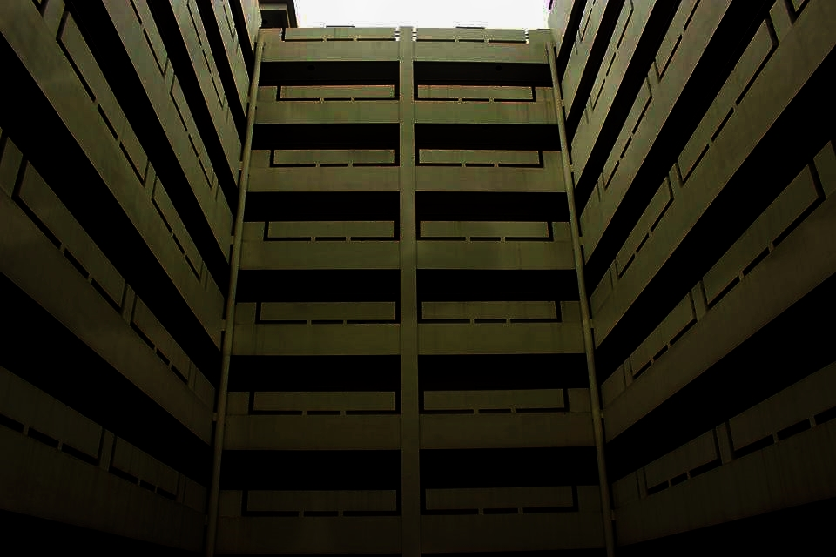
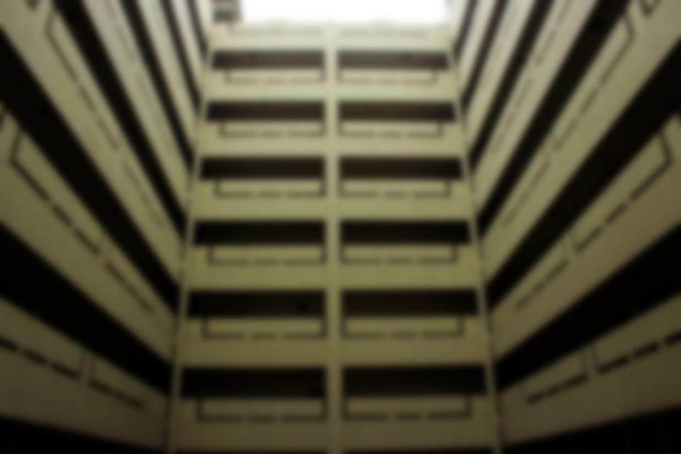
Functional Requirements
Result 1
Result 2
Result 3
1.Every student and hall stuff, manager, authority shall be uniquely identified by their id which they will use as their username to sign in to their accounts.
2. The students shall be able to see the notices in the home page.
3. There shall be individual accounts for each students, hall manager, hall staff and the administrator
We will provide them the opportunity to sign their meal online using their own account. Thus they can sign their meal from their own rooms or anywhere and the time given can also be increased till 12 am

Slide 17
Functional Requirements
Result 1
Result 2
Result 3
4. Students shall be able to view the contact information of hall staffs and authority along with the dos and don’ts applicable for students residing at hall.
5. A student shall be allowed to alter certain permitted information like address, phone, email etc.
6. Signing in to the account shall enable a student to view to options
Hall bill
Mess bill
We will provide them the opportunity to sign their meal online using their own account. Thus they can sign their meal from their own rooms or anywhere and the time given can also be increased till 12 am

Slide 18
Functional Requirements
Result 1
Result 2
Result 3
7. Students are allowed to sign the meal for the next day just the day before.
8. Hall staffs shall be able to view list of students who signed their meal. He has the authority to deactivate meal signing option of a student if he hasn’t cleared his dues.
9. Hall staffs shall insert the list of groceries bought and the amount deposited by the students every month.
We will provide them the opportunity to sign their meal online using their own account. Thus they can sign their meal from their own rooms or anywhere and the time given can also be increased till 12 am

Slide 19
Functional Requirements
Result 1
Result 2
Result 3
10. The hall manager and the hall authority shall have the authority to see the amount of bills paid by all the students till now and also the monthly amount of expenses of the hall in detail.
11.The hall manager can post urgent notices in the notice section and he can allocate or cancel hall seats.
We will provide them the opportunity to sign their meal online using their own account. Thus they can sign their meal from their own rooms or anywhere and the time given can also be increased till 12 am

Slide 20
Non Functional Requirements
In systems engineering and requirements engineering, a non-functional requirement is a requirement that specifies criteria that can be used to judge the operation of a system, rather than specific behaviors.In short, non-functional requirements describe how the system works.

Slide 21
Non Functional Requirements
Performance Requirement
Space Requirement
Usability Requirement
Dependability Requirement
Security Requirement
Operational Requirement
Environment Requirement
Development Requirement
Accounting Requirement

Slide 22

Conclusion
We sincerely wish that the software we are about to create will ease out the hall life for students and also suffice the hall management committee to carry out necessary works in a smooth and reliable manner.

Slide 23
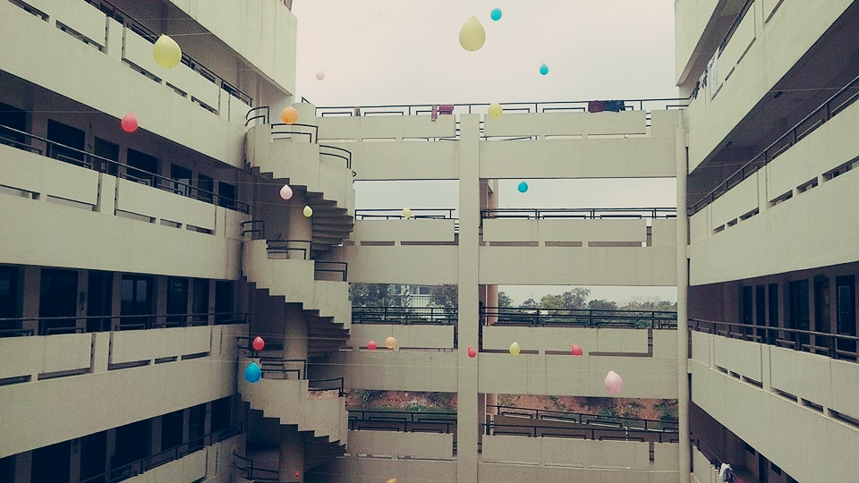
THANK YOU

Slide 24
